Slide 1
Objectives
  In this lesson, you will learn about:
    The features of Enterprise JavaBeans
    Various components of EJB architecture
    Roles and responsibilities provided by EJB specification
    Different types of Enterprise JavaBeans
    Components of Enterprise JavaBeans

Slide 2
Enterprise JavaBeans
  Overview of EJB
    EJB is a server-side component architecture that simplifies the process of building enterprise-level, distributed applications in Java.
    EJB components are deployed in EJB containers of J2EE-compliant application servers, such as J2EE 1.4, Weblogic, and JBoss.
    Characteristics of EJB:
      Hides server-side system level issues from developers.
      Defines a standard component architecture that enables you to build distributed object-oriented business applications.
      Facilitates creating enterprise-level applications by allowing easy integrating with other EJB components as well as with other components, such as servlets, Java Server Pages (JSP), and Java Beans.
      Enables you to create components and applications that are reusable across various J2EE-compliant servers.

Slide 3
Enterprise JavaBeans (Contd.)
      The server-side components deployed on the application servers can be implemented using various technologies, such as EJB and Microsoft’s COM/DCOM.
      Enterprise JavaBeans are different from JavaBeans, another similarly named Sun Microsystems component based technology.
      Examples of real-life applications where you can use the EJB component architecture are:
        Online share trading application
        Online reservation application
        Online catalog application
        Online library application

Slide 4
Enterprise JavaBeans (Contd.)
  EJB in J2EE Architecture
    The J2EE platform uses an N-tiered application model.
      Client tier: Controls the interaction of the application with the user. The clients of this tier can be a browser client, a Java client, applets, or midlets.
      Web tier: Contains J2EE Web components, such as servlets and Java Server Pages(JSP) to enable communication between Web clients.
      Enterprise JavaBeans tier: Contains EJB components to implement the business logic of an application.
      Enterprise Information System (EIS) tier: Contains the information infrastructure of the application. The EIS tier can contain relational databases, legacy databases, and Enterprise Resource Planning (ERP) systems.

Slide 5
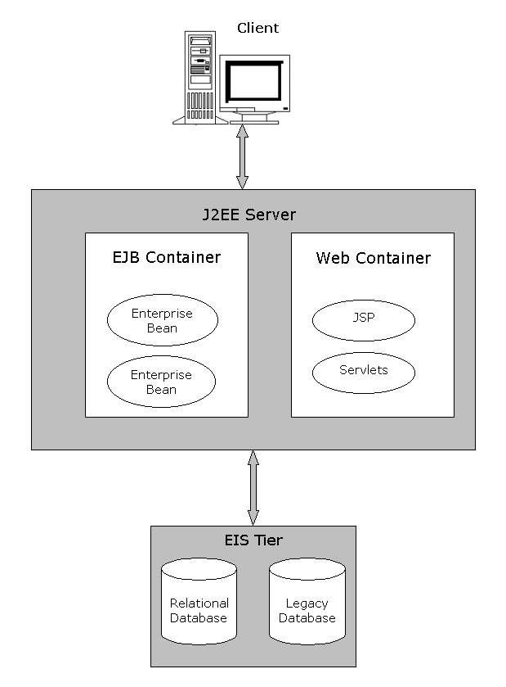
Enterprise JavaBeans (Contd.)
  Architecture of a J2EE application

Slide 6
Enterprise JavaBeans (Contd.)
    The J2EE server consists of containers to provide the runtime environment for different J2EE components.
    The EJB container stores the enterprise beans that implement the business logic of enterprise-level applications.
    EJB container provides various services:
      Persistence: EJB container manages the persistence of data for enterprise beans that are declared as Container Managed Persistence (CMP).
      Transaction management: EJB container manages the transactions for different enterprise beans of an EJB application. A transaction is a set of operations that is executed as a single unit.
      Security: EJB container provides security by allowing only authorized clients to access enterprise beans.

Slide 7
Enterprise JavaBeans (Contd.)
    Life cycle management: EJB container manages the life cycle of an enterprise bean and is responsible for changing the state of an enterprise bean as per client requests.
    Database connection pooling: EJB container creates a pool of database connections and allocates these connections to the enterprise bean as and when required.
    Remote client connectivity: EJB container allows clients at remote locations to access methods of an enterprise bean stored in the J2EE Server.

Slide 8
Enterprise JavaBeans (Contd.)
    The EJB container is also responsible for providing several Application Programming Interface (API) to support the running and deployment of an EJB.
    Various APIs provided by the EJB container are:
      Java Platform, Standard Edition, (J2SE) API
      EJB Standard Extension
      JDBC Standard Extension
      JNDI Standard Extension
      JMS Standard Extension
      JavaMail Standard Extension (for sending mail only)
      JAXP
      JTA Standard Extension (Only UserTransaction interface)

Slide 9
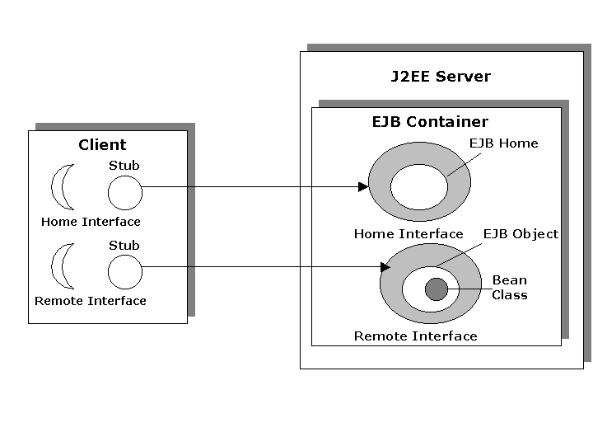
Enterprise JavaBeans (Contd.)
    EJB Architecture

Slide 10
Enterprise JavaBeans (Contd.)
  Various components of EJB architecture are:
    EJB Container: Provides the runtime environment for the EJB components and services, such as life cycle management, connection pooling, and security.
    EJB Component: Java classes that follow the EJB specification to implement the business logic of an application. EJB components are deployed in EJB container and are accessed using the remote and home interfaces of an enterprise bean.
    EJB Object: EJB container generates an EJB object, when a client needs to access an instance of the enterprise bean. The EJB object acts as an interface between the client and bean instances.
    Home Object: Home objects are generated by EJB container. Clients access EJB objects that are stored at different Java Virtual Machines (JVM), using the home object.

Slide 11
Enterprise JavaBeans (Contd.)
  EJB Roles and Responsibilities
    Bean provider
    Application assembler
    EJB deployer
    EJB server provider
    EJB container provider
    System administrator
  The bean provider is responsible for building the EJB components or enterprise beans by creating Java class files for them. After creating Java class files, the bean provider packages them into ejb-jar files.
  The application assembler is responsible for assembling different EJB components in order to build a complete application.

Slide 12
Enterprise JavaBeans (Contd.)
    Responsibilities of the application assembler are:
      Analyzing a business problem and assembling EJB components accordingly to solve the problem.
      Building new EJB components.
      Writing the integration code required to associate the EJB components built by different bean providers.
    The EJB deployer is responsible for deploying an assembled application in an application server. The EJB deployer is also responsible for customizing enterprise beans.
    The EJB server provider is responsible for providing EJB server, which manages client access to an application in a distributed environment. The EJB server provides a run-time environment, which conforms to the EJB specification.
    The EJB container provider is responsible for developing a container that is secure, scalable, and transaction-enabled.

Slide 13
Enterprise JavaBeans (Contd.)
    The EJB container provider’s responsibilities are:
      Providing the deployment tools that are required by the deployer for deploying EJB components.
      Providing run-time support for beans that are deployed on EJB server. Run-time support includes managing transactions, distributing network resources between clients, and managing scalability of resources.
    The system administrator is responsible for managing and running an EJB application.
    The system administrator’s responsibilities are:
      Configuring and managing the network infrastructure of an EJB application.
      Managing the working of EJB server and EJB container.
      Monitoring the working of deployed EJB applications.

Slide 14
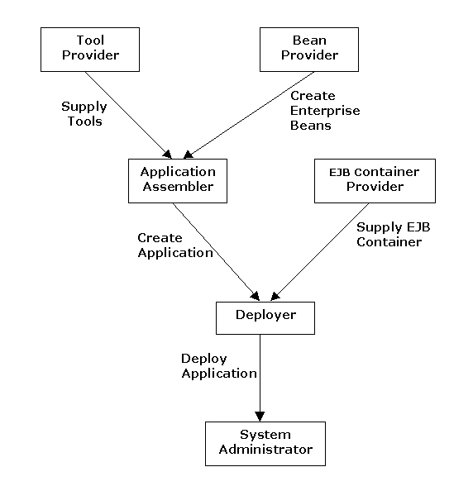
Enterprise JavaBeans (Contd.)
    Various EJB roles and their interaction

Slide 15
Enterprise JavaBeans (Contd.)
  Types of EJB
    The EJB specification defines different types of enterprise beans to implement the business logic of an EJB application.
    The three types of beans are:
      Session beans
      Entity beans
      Message-driven beans

Slide 16
Enterprise JavaBeans (Contd.)
    Session beans:
      Implement the business processes in an application.
      Have the following types:
        Stateless: This type of session bean does not maintain the state of the client across various method calls.
        Stateful: This type of session bean maintains the state of a client across various method calls by the same client.

Slide 17
Enterprise JavaBeans(Contd.)
    Entity beans:
      Are Java components that can access and store persistent data in a relational database.
      Implement business objects in an EJB application.
      Have the following types:
        Bean-Managed Persistence (BMP): This bean enables you to manage database queries and connectivity issues. You need to write the codes for establishing database connectivity and querying database tables in the bean class file.
        Container-Managed Persistence (CMP): This bean enables EJB container to manage database queries and connectivity issues. Database connectivity is implicitly managed by EJB container.

Slide 18
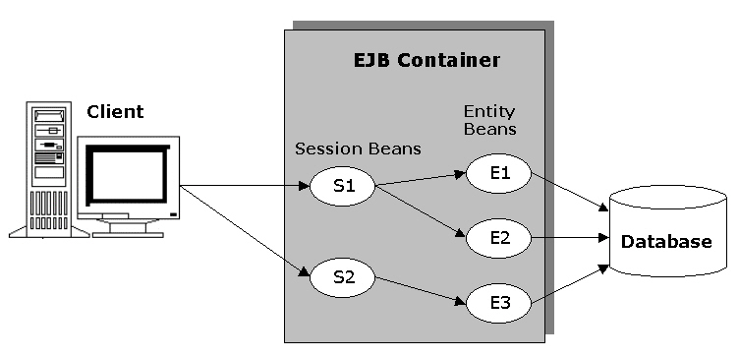
Enterprise JavaBeans(Contd.)
  Interaction between session beans and entity beans in an EJB application:

Slide 19
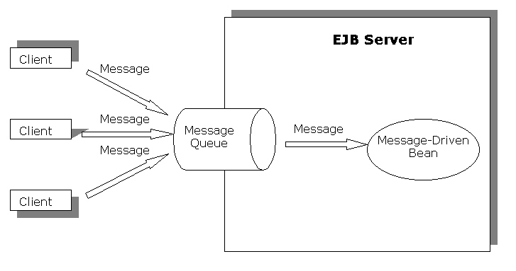
Enterprise JavaBeans(Contd.)
  Message-driven beans:
    Implement the business logic that requires asynchronous messaging between components of an EJB application.
    Allow processing of Java Messaging Service (JMS) messages in the J2EE architecture.
    Can send and receive messages asynchronously thereby speeding up the process of messaging in J2EE.
  Use of message-driven beans in EJB applications is as follows:

Slide 20
EJB Components and Programming Restrictions
  Components of an enterprise bean are:
    Enterprise Bean Class: It consists of various methods that implement the business logic of an enterprise bean. The bean class also implements life cycle methods of an enterprise bean.
    EJB Object: It is a container-generated object that interacts with the client, on behalf of EJB container, to provide services, such as transaction control, security, and persistence.
    Remote Interface: It declares methods, which an enterprise bean provides to clients in order to enable them to perform business operations.
    Home Object: It is a container-generated object that provides methods to create, find, and remove EJB objects. This object implements methods of the home interface.

Slide 21
EJB Components and Programming Restrictions (Contd.)
      Home Interface: It declares the various life cycle methods that involve operations, such as creating, finding, and removing enterprise beans.
      Local Interfaces: These are used when the enterprise bean and the client are stored in the same JVM.

Slide 22
EJB Components and Programming Restrictions (Contd.)
  The Enterprise Bean Class
    The enterprise bean class of an EJB application is a Java class that contains the methods to implement the business logic of an EJB application.
    To create an enterprise bean class for a session bean, you need to implement the javax.ejb.SessionBean interface.
    You need to implement the javax.ejb.EntityBean and javax.ejb.MessageDrivenBean interfaces for creating the enterprise bean class for entity and message-driven beans, respectively.

Slide 23
EJB Components and Programming Restrictions (Contd.)
  The Remote Interface
    The remote interface declares the business methods of an enterprise bean, which can be invoked by a client that is stored at a remote JVM.
    The rules to create a remote interface file are:
      It should extend the javax.EJBObject interface.
      It should contain a declaration of all the methods that are accessible to the clients.
      All the methods that is remotely accessible to client must throw an exception of type java.rmi.RemoteException. This type of exception is raised when a network connection failure occurs.

Slide 24
EJB Components and Programming Restrictions (Contd.)
    The remote interface inherits following methods from the javax.ejb.EJBObject interface:
        getEJBHome()
        getPrimaryKey()
        remove()
        getHandle()
        isIdentical()

Slide 25
EJB Components and Programming Restrictions (Contd.)
  EJB Object:
    Is a container-generated Java class file containing all the business methods that an enterprise bean provides to its clients.
    Provides services, such as transaction support, security, resource management, persistence, and remote accessibility.
    Implements the intermediate services before forwarding the client call to the enterprise bean instance for servicing client request.

Slide 26
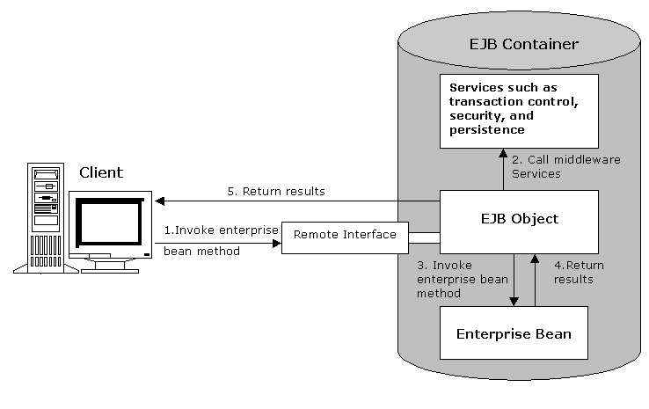
EJB Components and Programming Restrictions (Contd.)
    EJB object acts as an intermediate between a client and an enterprise bean instance as shown below:

Slide 27
EJB Components and Programming Restrictions (Contd.)
  The Home Interface:
    Involves declaring the various life cycle methods of an enterprise bean.
    Should import the following packages:
      java.io.Serializable
      java.rmi.RemoteException
      javax.ejb.CreateException
      javax.ejb.EJBHome
    Should extend the EJBHome interface and its name should not be a keyword in Java.
    Should contain a create() method whose return type is the same as the type of the remote interface of the enterprise bean. The create() method is responsible for creating a new instance of enterprise bean.

Slide 28
EJB Components and Programming Restrictions (Contd.)
    Inherits methods from the javax.ejb.EJBHome interface
      getEJBMetaData()
      getHomeHandle()
      remove()

Slide 29
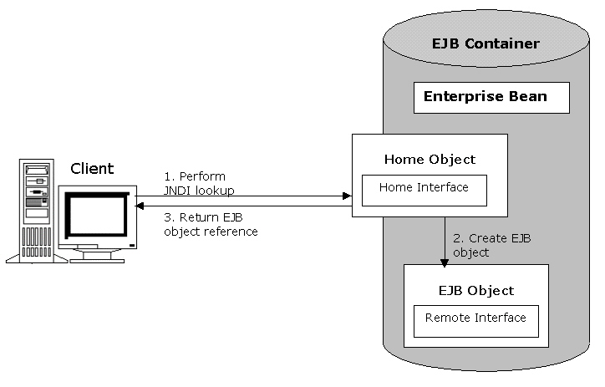
EJB Components and Programming Restrictions (Contd.)
  EJB Home interface is used to create an EJB object:

Slide 30
EJB Components and Programming Restrictions (Contd.)
  The Home Object:
    Is a container-generated object responsible for instantiating and managing EJB objects.
    Enables clients to instantiate an EJB object that is stored in a remote JVM.
    Performs the following functions:
      Creating EJB objects
      Searching for EJB objects
      Removing EJB objects

Slide 31
EJB Components and Programming Restrictions (Contd.)
  The Local Interfaces:
    Are created when the client and the enterprise bean are stored on the same JVM.
    Are of two types:
      local interface
      local home interface

Slide 32
EJB Components and Programming Restrictions (Contd.)
    The advantages of using local interfaces
      Improved performance: The time required in calling methods of one EJB component from another decreases, improving the overall performance of the EJB application.
      Sharing of data: Data can be shared between the calling component and the enterprise bean because the arguments to the methods in a local and local home interface are passed by reference.

Slide 33
EJB Components and Programming Restrictions (Contd.)
    Creating the Local Interface
      Local interface:
        Contains the declaration of the methods, which are accessible to the clients.
        Is created by extending the javax.ejb.EJBLocalObject interface.

Slide 34
EJB Components and Programming Restrictions (Contd.)
  Creating the Local Home Interface
    Local home interface:
      Contains the same set of functions as the home interface.
      Is created by extending the javax.ejb.EJBLocalHome interface.

Slide 35
EJB Components and Programming Restrictions (Contd.)
  The Deployment Descriptor:
    Is an eXtensible Markup Language (XML) file with the name ejb-jar.xml that contains information about middleware services, such as transaction and security required by EJB components.
    Provides EJB Container information regarding the type of enterprise bean and the names of the remote interface, home interface, and the bean class files.
    Contains various tags, such as <ejb-name> and <ejb-class>. The type and number of tags used varies according to the type of enterprise beans that a deployment descriptor describes.

Slide 36
EJB Components and Programming Restrictions (Contd.)
    Commonly used tags used in a deployment descriptor:
      <ejb-jar>: Is the basic tag of an enterprise bean. All other tags of a deployment descriptor are specified inside this tag.
      <enterprise-beans>: Contains the declarations of all the enterprise beans that the deployment descriptor describes.
      <ejb-name>: Specifies the name of the enterprise bean.
      <home>: Specifies the name of the home interface of an enterprise bean.
      <remote>: Specifies the name of the remote interface of an enterprise bean.
      <ejb-class>: Specifies the name of an enterprise bean class.

Slide 37
EJB Components and Programming Restrictions (Contd.)
    Packaging EJB Components
      An EJB application and its various components are deployed and distributed in the form of packages.
      The process of packaging:
        Enables you to handle and use multiple files related to one EJB component, simultaneously.
        Saves disk space by compressing files.
      The EJB components of an EJB application are packaged into Java Archive (JAR) files and the Web components are packaged into Web Archive (WAR) files.

Slide 38
EJB Components and Programming Restrictions (Contd.)
      The components of an enterprise bean are packaged as an ejb-jar file.
      The various component files that are packaged into an ejb-jar file are:
        Bean class file
        Remote interface file
        Local interface file
        Local home interface file
        Home interface file
        Deployment descriptor file

Slide 39
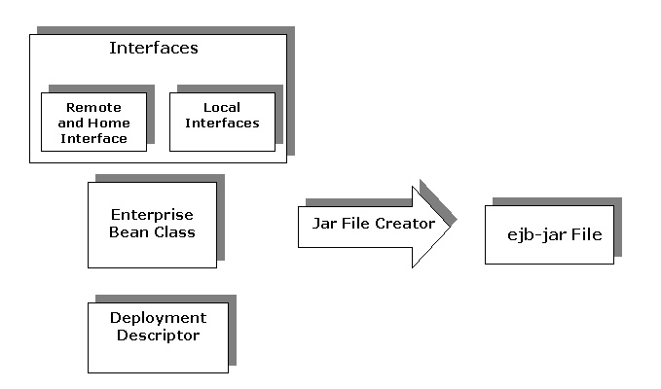
EJB Components and Programming Restrictions (Contd.)
    Packaging an enterprise bean

Slide 40
EJB Components and Programming Restrictions (Contd.)
  Programming Restrictions in EJB are:
    The EJB specification defines certain programming restrictions to prevent the programming of system-level services by programmers.
    The programming practices that should be avoided are:
      Using the java.io package to access files and directories.
      Using Abstract Window Toolkit (AWT) to display data and enter information using keyboard.
      Performing thread management operations, such as starting and stopping threads.
      Performing socket operations, such as listening to and accepting socket connections or using a socket for multicast.
      Performing thread synchronization.
      Setting a socket factory used by Socket and ServerSocket, or the stream handler socket factory.

Slide 41
EJB Components and Programming Restrictions (Contd.)
      Loading native libraries.
      Performing class loader operations, such as creating, obtaining, and setting the class loader.
      Reading or writing a file descriptor directly.
      Defining a class in a package.
      Accessing and modifying the various security configuration objects, such as Policy, Security, Provider, Signer, and Identity.
      Using the subclass and object substitution features of Java serialization protocol.
      Passing this as an argument or method result.
      Obtaining security policy information for a particular code source.
      Performing certain security-related operations, such as setting and creating security manager.

Slide 42
Summary
In this lesson, you learned:
  EJB is the server-side component architecture that enables you to develop the distributed enterprise-level applications in Java.
  An EJB application consists of three components: J2EE server, client, and database. The J2EE server contains deployed EJB components that are also known as enterprise beans.
  The EJB tier consists of various components, such as EJB server, EJB container, stubs, skeletons, and the remote and home interfaces.
  EJB container is responsible for providing system-level services to enterprise beans. System level services include network connections, transaction control security, and run time services.
  Enterprise beans are of three types: session beans, entity beans, and message-driven beans.
  An enterprise bean consists of various components, such as remote interface, home interface, and bean class file.

Slide 43
Summary (Contd.)
  EJB container generates two objects, EJB home object and EJB object, which facilitate the interaction between a client and an enterprise bean.
  Local interfaces enable you to make the calling process between two components of an EJB application faster. The process is faster because both the components are stored at the same JVM and the calls do not have to go through stubs, skeletons, and network calls.
  The deployment descriptor in EJB is an XML file that specifies the features of an enterprise bean to EJB container.
  EJB components are distributed and deployed in the form of packages. A package stores the various files that constitute the EJB component as a single file.
  The EJB specification defines the certain programming restrictions required for preventing the programming of system level services by programmers.

